Slide 1
Brain Tumor MRI Classification
University of Information Technology (UIT) – VNU HCMC
Introduction to Computer Vision – CS231
Quan Hoang Ngoc - 22521178
Professor: PhD. Dung Mai Tien
5/2024

Slide 2
01
Introduction
02
Problem Statement
Methodology and Pipeline
03
Table of
Contents
Evaluation Method
04
Result Experiment
05
Discussion
06
07
Visualization

Slide 3
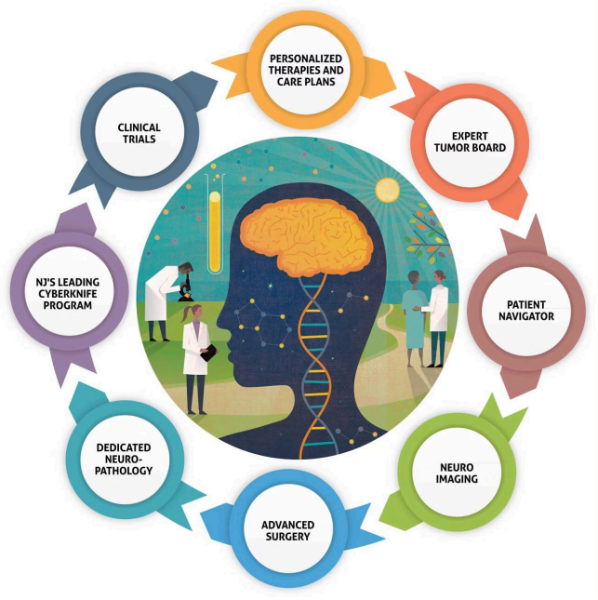
Table of Contents

Slide 4
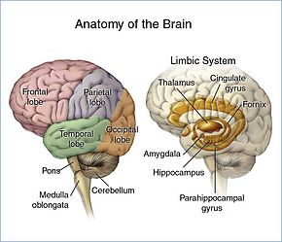
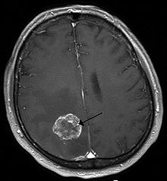
Introduction
Why it matters?
Brain tumor classification: is a crucial task in medical imaging for accurate diagnosis and treatment planning.
Invasive diagnostic methods of WHO: not allow rapid diagnosis in a clinical trial, expensive cost
Non-invasive diagnostic methods base on MRI, CT: help rapid diagnosis and accurately classify

Slide 5
Problem
Input:
Inference: a brain MRI image, which can be a 2D slice.
Training: a dataset consists of labeled images with the corresponding class for each image (the label should indicate the type of tumor in the brain MRI image and each image can only be assigned a unique label).
Output:
The output of the model is a classification label, which can be probability scores indicating the likelihood of belonging to a specific tumor class.
These classes include: meningioma (M), glioma (G), pituitary (P) tumor, and no tumor (N).

Slide 6
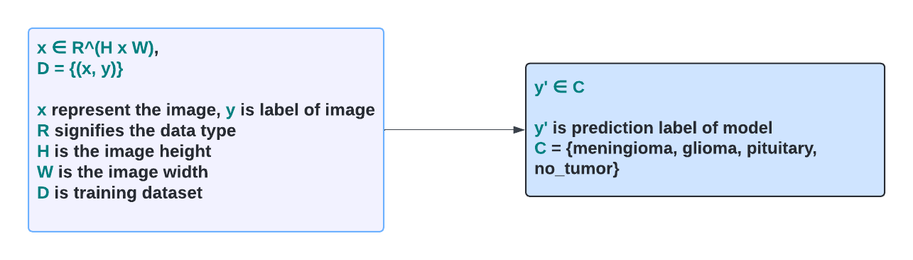
Problem
Input Output Formula
Constraint: The brain MRI image only contains a unique type of tumor in the classes.

Slide 7
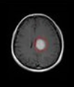
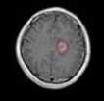
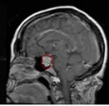
Problem
Inference illustration
Meningioma
Glioma
Pituitary

Slide 8
Contribution
The aim of research project
The aim of this research project is to develop methods that can accurately classify the type of tumor to ensure generalizability and discrimination.
Besides, we also perform a comprehensive comparison of various feature extraction methods and evaluate their effectiveness. Analyze experimental results and point out their advantages and disadvantages.
Finally, we find out the potential of model resonation that use an ML method.

Slide 9
Methodology
Related work
Various approach for brain tumor MRI classification
In the early time: - Traditional ML used such as combine PCA and LDA (V.P.Gladis-2012-79 cites)
In recent years: - With the development of Deep Learning, methods such as CNN, RCNN, transfer learning emerged and showed amazing results.
(Zar-2019-491 cites, Milica-2020-302 cites, Ramdas-2022-62cites, Zahid-2023)

Slide 10
Methodology (1)
HOG feature extraction
HOG: Histogram of Oriented Gradients, first described by Robert K. McConnell of Wayland Research Inc. A feature descriptor technique commonly used in object detection and recognition tasks.
Purpose: capture local edge information, which are essential for shape and object recognition

Slide 11
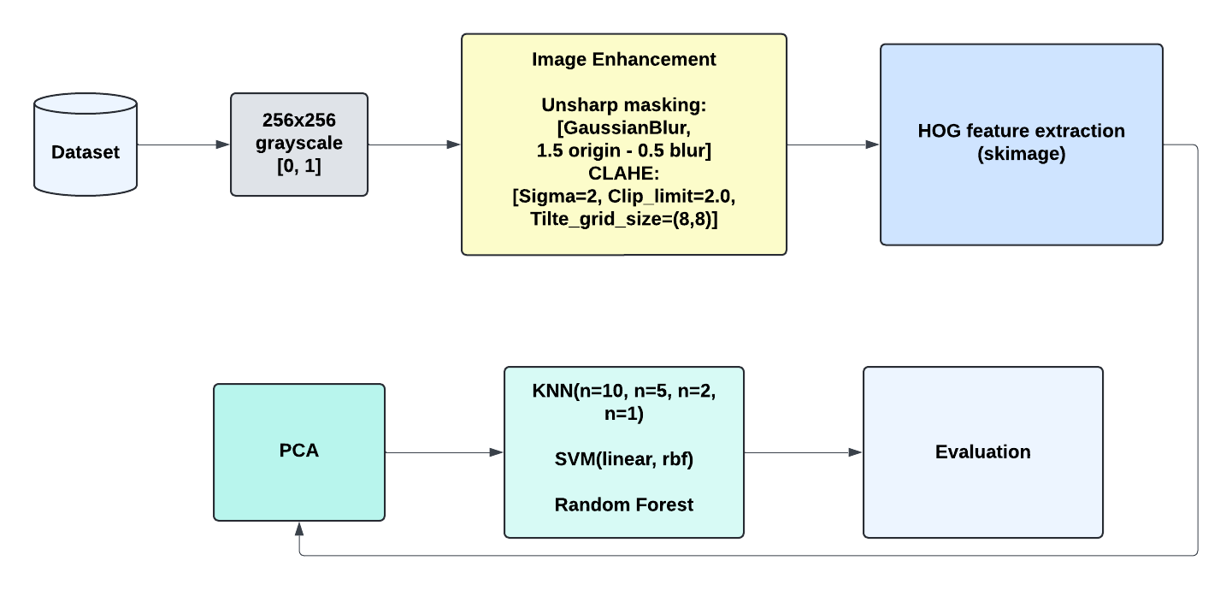
Pipeline
Feature extraction + Training - Evaluation
Brain Tumor Classification from MRI Using Image Enhancement and Convolutional Neural Network Techniques - PMC (nih.gov) - 2023 - Same Dataset

Slide 12
Limitation of HOG
Curse of Tumor
Within the same tumor type, there can be many different shape depending on the different stages of the tumor.
Besides, different types of tumors may share a similar shape.
But, there is a key insight that: Location of tumor is one of the Key Distinguishing Factors.
And, the intensity of tumor is frequently different from the rest.

Slide 13
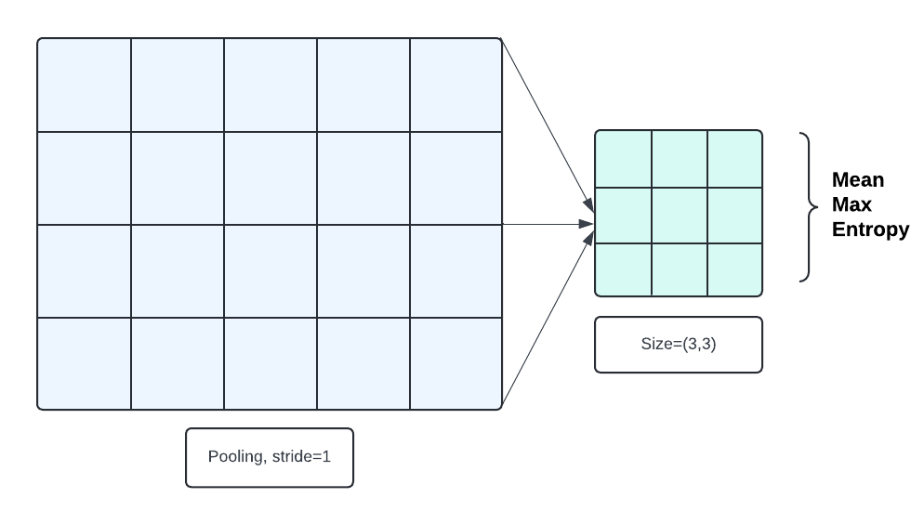
Methodology (2)
Local Statistics Intensity Based feature extraction
Purpose: capturing texture, contrast, and spatial relationships between different intensity distribution in images

Slide 14
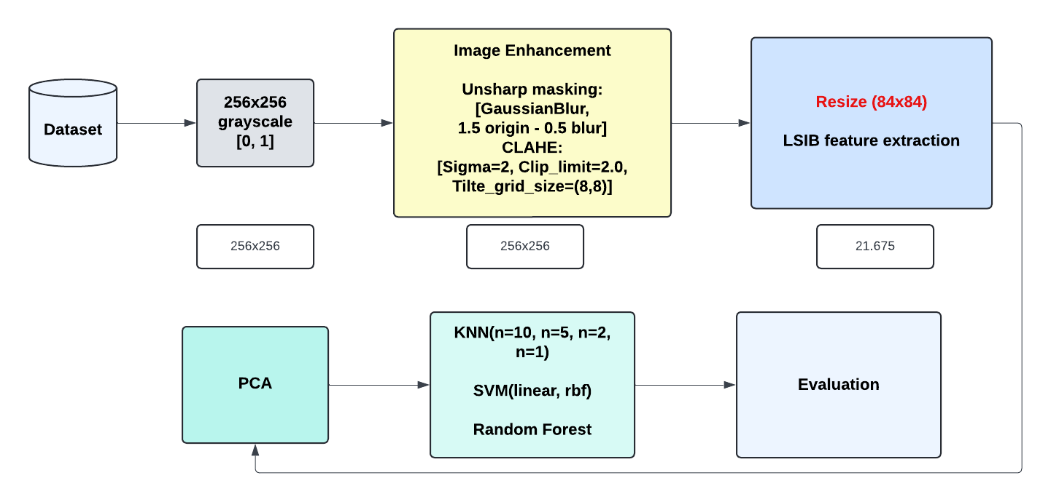
Pipeline
Feature extraction + Training - Evaluation

Slide 15
LSIB illustration

Slide 16
Can be improved?
Combine LSIB with HOG
How to isolate the tumor region and capture broader spatial relationships between different parts of the image
Focus specifically on the tumor region and extracting relevant features of tumor instead of the entire brain.

Slide 17
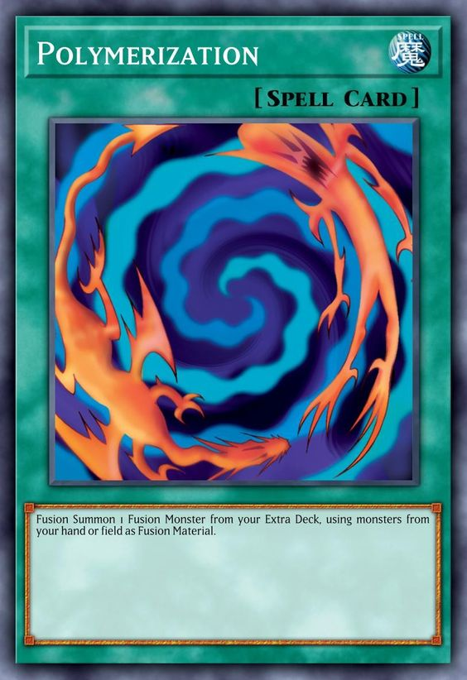
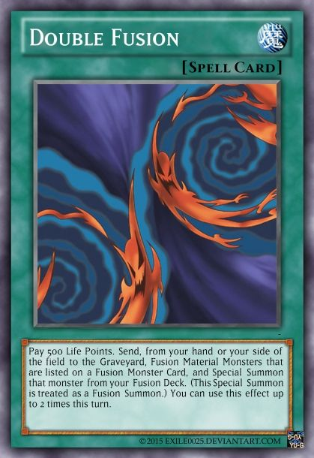
Fusion Dance
Segmentation based Classification
Combine LSIB and HOG
Combine Segmentation and Classification

Slide 18
Methodology (3)
Segmentation based Classification: Related work
Ramdas and Mohd Computer Science & Engineering at Osmania University Hyderabad, India
Department of Computer Science & Engineering University College of Engineering (A). Osmania University Hyderabad, India
Brain tumor MRI images identification and classification based on the recurrent convolutional neural network - ScienceDirect - 2022 - 62 cites.

Slide 19
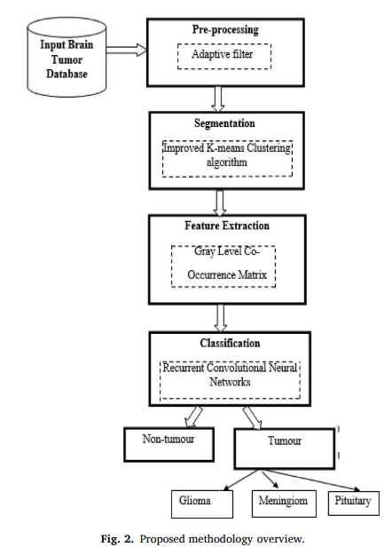
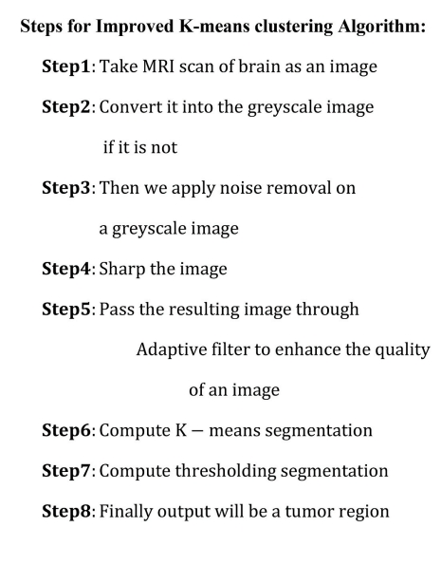
Methodology (3)
Related work: I&C + RCNN

Slide 20
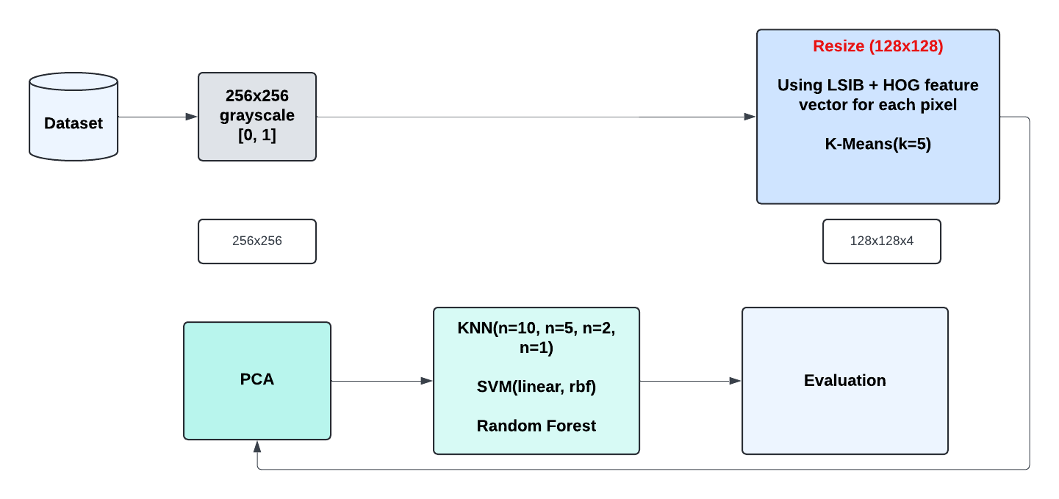
Pipeline
Feature extraction + Training - Evaluation

Slide 21
Segmentation illustration

Slide 22
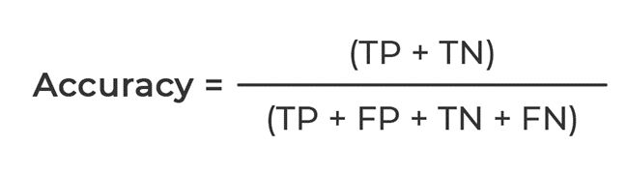
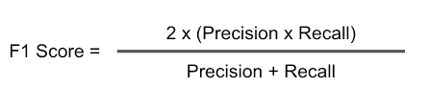
Evaluation Method
Mertrics
To meet the core aim of this research project, we use:
Accuracy: The proportion of correctly classified instances to the total number of instances.
F1-score: The harmonic mean of precision and recall, providing a balance between the two metrics.

Slide 23
Evaluation Method
Dataset
Brain tumor MRI dataset Cheng [2017], Amin et al. [2022]
This dataset is a combination of the following three datasets: Figshare, Sartaj, and Br35H. This dataset contains 7023 images of human brain MRI images as a set of 2D slices, not 3D volume.
The dataset are classified into 4 classes: glioma - meningioma - no tumor and pituitary.
Out of these, the dataset curator created the training and testing splits. We followed their splits 5.712 images for training and 1.311 for testing.
Brain Tumor MRI Dataset Benchmark (Classification) | Papers With Code - 2022 - SoTA - CASS – DINO

Slide 24
Evaluation Method
Dataset
Testing
G | M | N | P
300 | 306 | 405 | 300 | 1311
Training
G | M | N | P
1321 | 1339 | 1595 | 1457 | 5712

Slide 25
Evaluation Method
Testing Method
To test the generalization capability of methods in medical diagnostics, we use a K-Fold cross-validation method for training and testing methods' performance (set up following sklearn library with K-Fold=4, and x5 time cost for all experiments).
Besides, to ensure the objectivity of the evaluation, we keep the testing set of the dataset, and also evaluate the final results on this testing set.

Slide 26
Result Experiment (1)
Comprehensive results using HOG

Slide 27
Result Experiment (2)
Comprehensive results using LSIB
 | KNN-10 | KNN-5 | KNN-2 | KNN-1 | SVM-ln | SVM-rbf | RF
mCV acc | 0.8633 | 0.8934 | 0.9340 | 0.9401 | 0.9084 | 0.9119 | 0.8598
acc | 0.8291 | 0.8810 | 0.9603 | 0.9733 | 0.9252 | 0.9039 | 0.8940
F1-score | 0.8103 0.8167 | 0.8700 0.8734 | 0.9580 0.9604 | 0.9715 0.9731 | 0.9193 0.9248 | 0.8975 0.9025 | 0.8852 0.8924

Slide 28
Result Experiment (3)
Comprehensive results using Segmentation vs LSIB
 | KNN-10 | KNN-5 | KNN-2 | KNN-1 | SVM-ln | SVM-rbf | RF
mCV acc | 0.8633 | 0.8934 | 0.9340 | 0.9401 | 0.9084 | 0.9119 | 0.8598
acc | 0.8291 | 0.8810 | 0.9603 | 0.9733 | 0.9252 | 0.9039 | 0.8940
F1-score | 0.8103 0.8167 | 0.8700 0.8734 | 0.9580 0.9604 | 0.9715 0.9731 | 0.9193 0.9248 | 0.8975 0.9025 | 0.8852 0.8924
mCV acc | 0.8403 | 0.8725 | 0.8965 | 0.9326 | 0.8920 | 0.9035 | 0.8181
acc | 0.8032 | 0.8604 | 0.9207 | 0.9756 | 0.9237 | 0.9092 | 0.8703
F1-score | 0.7820 0.7887 | 0.8484 0.8532 | 0.9122 0.9156 | 0.9735 0.9755 | 0.9181 0.9233 | 0.9033 0.9083 | 0.8588 0.8684
LSIB
Seg

Slide 29
Result Experiment (2*)
Comparision results using Segmentation vs LSIB
 | Top 3 | Unique Top 3 | The best
mCV acc | 0.9287 | 0.9039 | 0.9401
acc | 0.9529 | 0.9308 | 0.9733
F1-score | 0.9496 0.9528 | 0.9253 0.9301 | 0.9715 0.9731
mCV acc | 0.9109 | 0.8847 | 0.9326
acc | 0.9400 | 0.9232 | 0.9756
F1-score | 0.9346 0.9381 | 0.9168 0.9224 | 0.9735 0.9755
LSIB
Seg

Slide 30
Result Experiment (3*)
Comparision results with Related work
Method | Dataset | CV accuracy | Accuracy | F1-score
Enh + HOG (the best) | BRMRI 2022
Enh + Statistics (the best) | BRMRI 2022 | 0.9401 | 0.9733 | 0.9715 0.9731
Segmentation (the best) | BRMRI 2022 | 0.9326 | 0.9756 | 0.9735 0.9755
Enh + CNN - 2023 paper | BRMRI 2022 | None | 0.9784 | 0.9790
I&C + RCNN - 2022 paper | SARTAJ | None | 0.9517 | 0.9363 (89.28-98.42)
Xception FineTuning | BRMRI 2022 | 0.9739 | 0.9764 | 0.9750 0.9765

Slide 31
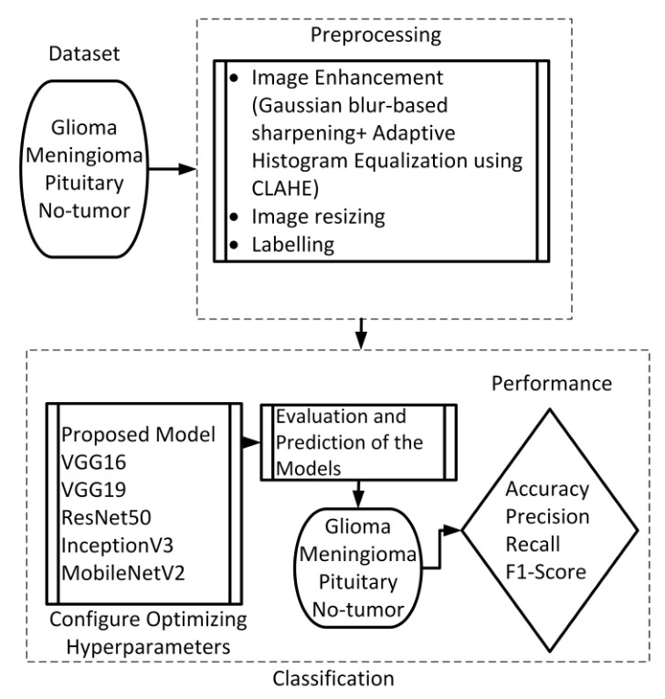
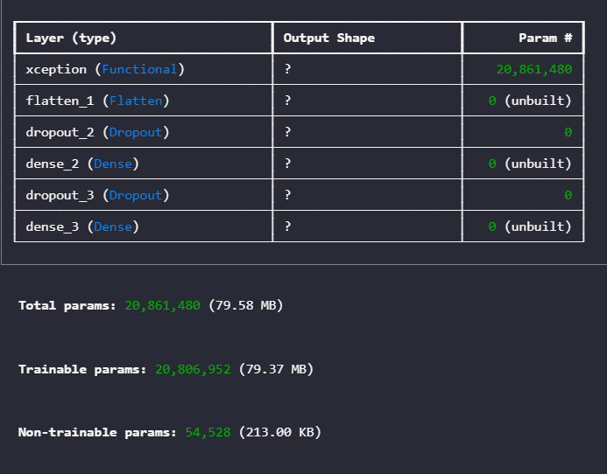
Result Experiment
Enh + CNN - 2023 paper
Xception FineTuning

Slide 32
Research Finding
Conclusion
We found the effectiveness of capture local edge information, shape of tumor and also texture, spatial relationship (location), different intensity distribution of tumor region for Brain Tumor MRI classification using feature extraction such as HOG, LSIB.
Besides, combining them can be an better way for the accurate identification and classification of complex tumors. However, spatial relationship, different intensity distribution features seem to be more essential.
Segmentation based classification could be a novel way that help isolate the tumor region and focus on them instead of entire brain.
The experiment result shows potential of model resonation by an ML segmentation method.
Amid the explosion of DL and CNN, our research shows that understanding and creatively combining traditional ML methods still shows effectiveness and has essential application values.

Slide 33
Limitation Finding

Slide 34
Visualization

Slide 35
Recommendation
Future Research Direction

Slide 36
Purpose of Convolution layers
Using multiple convolution layers in a CNN allows the network to learn increasingly complex features from the input image or video.
The first convolution layers learn simple features, such as edges and corners.
The deeper convolution layers learn more complex features, such as shapes and textures.
Purpose of Pooling layers
Pooling layers reduce feature map dimensions while retaining crucial information using operations like max pooling (selecting maximum values) or average pooling (calculating averages).

Slide 37
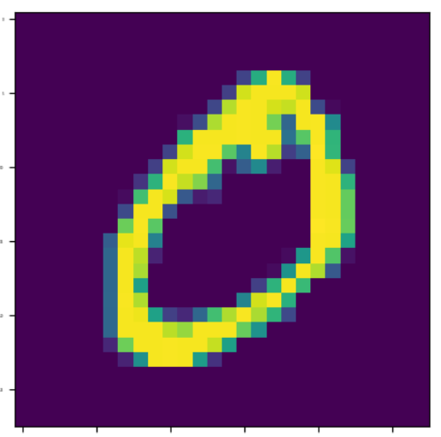
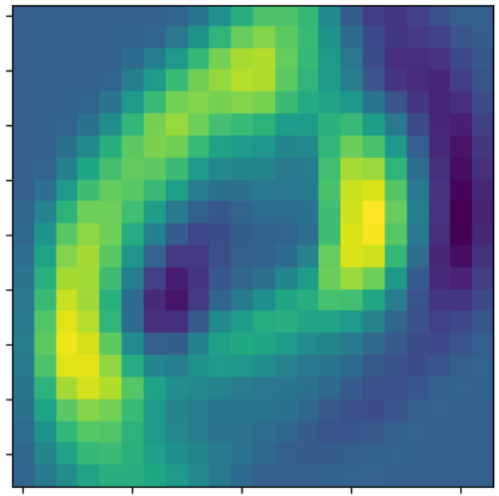
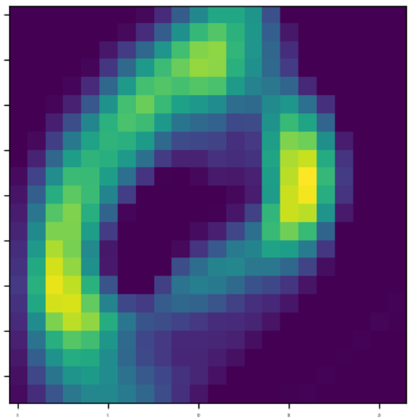
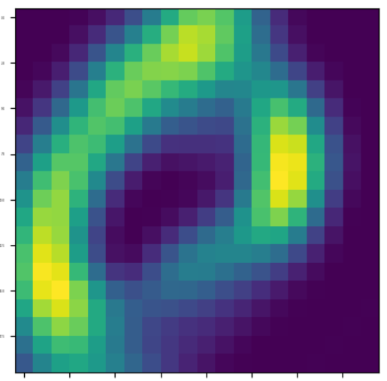
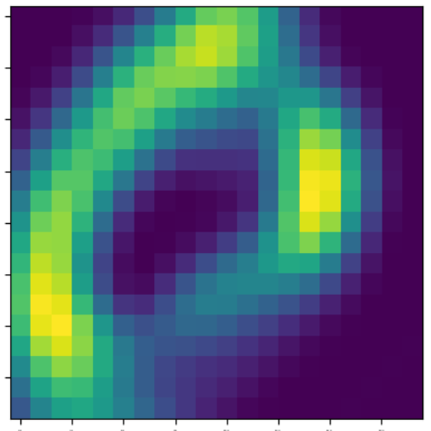
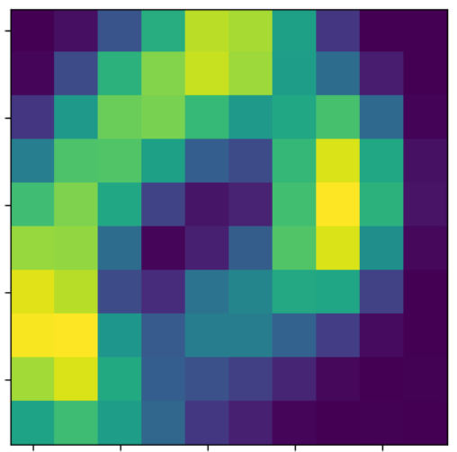
Visualization
MNIST digit 0 and 1
Image
Conv
ReLU
Conv
ReLU
Pooling
https://poloclub.github.io/cnn-explainer/

Slide 38
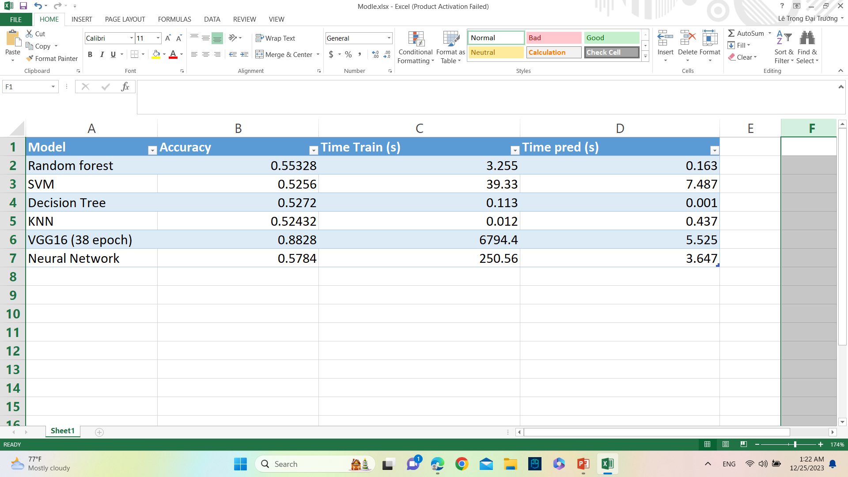
The experiment: Comparison of models
The result of Cat Dog Image Classification experiment

Slide 39
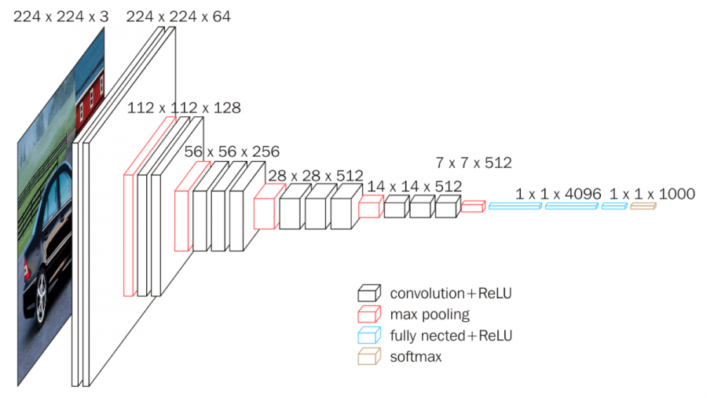
The experiment: Comparison of models
VGG 16

Slide 40
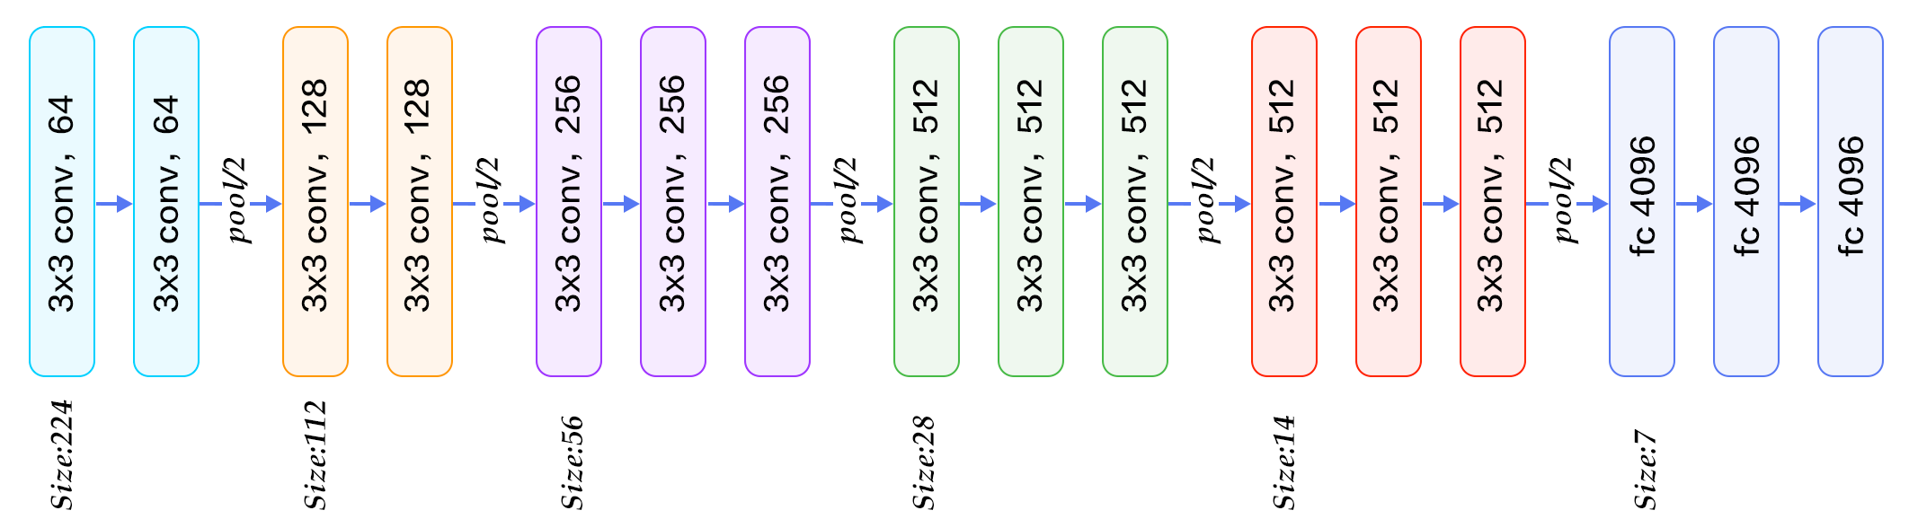
The experiment: Comparison of models
VGG 16

Slide 41
Advantages and Disadvantages of CNNs
Advantages:
Use raw pixel data
No require manual feature engineering (feature extractor) or pre-processing (PCA)
➔ Automatic feature extractor
➔ Adapt to the most salient characteristics of the images, such as edges, shapes, colors, textures, and objects → generalize well to new data and recognize pattern of image.
Reduce Dimensionally → training and inference faster and more efficient.
Transfer Learning, data argumentation.
Disadvantages:
Hard to interpret and explain: human interpretable.
Require a large amount of labeled data to train effectively.
Hardware: computation cost (GPU).
Overfitting.
Curse of Dimensionality.
https://www.linkedin.com/advice/0/what-advantages-disadvantages-using-convolutional

Slide 42
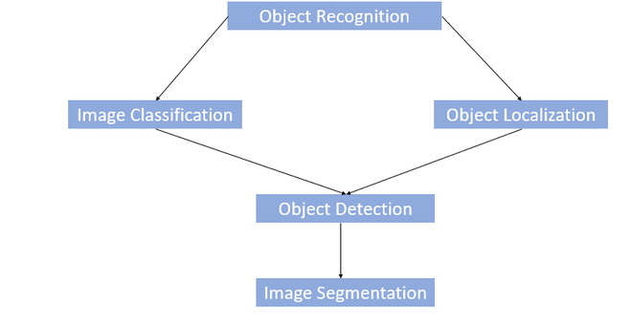
Tasks using CNN and applications
Image Classification
Object Recognition
Object Detection
Image Segmentation

Slide 43
LQD.QT Product
Shoes Match
Shoes Virtual Try-on
Dat Tran, Long Nguyen Huu Hoang, Quan Hoang Ngoc, Thu Tran Van Anh, Truong Le Trong Dai
LQD.QT
References: Paper ARShoe
Paper ARShoe: Real-Time Augmented Reality Shoe Try-on System on Smartphones (https://arxiv.org/pdf/2108.10515.pdf)

Slide 44
Thank you
THANKS

Slide 45

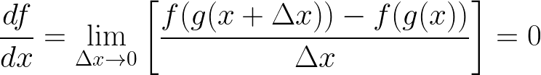


1. Chain Rule

Slide 46
Formular in Traditional Layers (Nerual Network)

Slide 47
Sourcecode Demo for Layers (ViCNN.ipynb)

Slide 48
Problem of Gradient Exploding and Vanishing
Activation,
Initialization Method, Training Update Method (Adam)
Visualization

Slide 49
Purpose of Convolution layers
Using multiple convolution layers in a CNN allows the network to learn increasingly complex features from the input image or video.
The first convolution layers learn simple features, such as edges and corners.
The deeper convolution layers learn more complex features, such as shapes and textures.
Purpose of Pooling layer
Convolution layers use learnable filters to detect specific patterns in input data, such as edges or textures, forming feature maps.
Pooling layers reduce feature map dimensions while retaining crucial information using operations like max pooling (selecting maximum values) or average pooling (calculating averages).

Slide 50
Top CNN Models
VGG
AlexNet
ResNet
GoogLeNet
MobileNet
R-CNN and Fast R-CNN, Faster R-CNN
https://datagen.tech/guides/computer-vision/cnn-convolutional-neural-network/

Slide 51
Visualization
https://poloclub.github.io/cnn-explainer/

